Slide 1
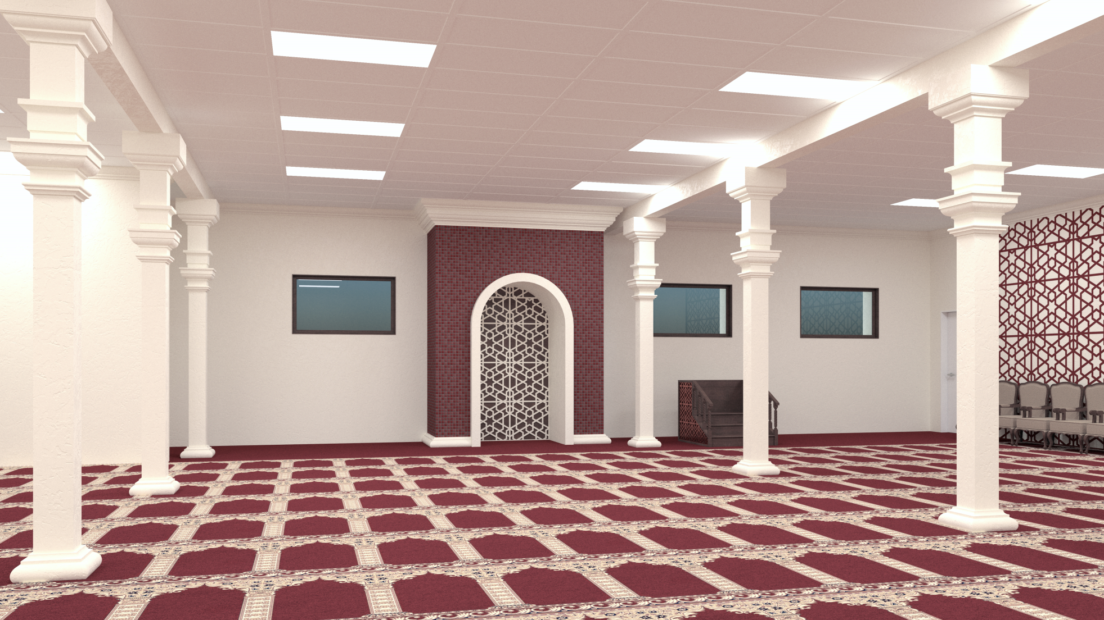
Noor Islamic & Cultural
Community Center
$ 500 per Praying Spot
Get/sponsor One as a Gift for YOUR Parents
An Excellent Father’s Day Gift
A Gift that Lasts for EVER!

Slide 2
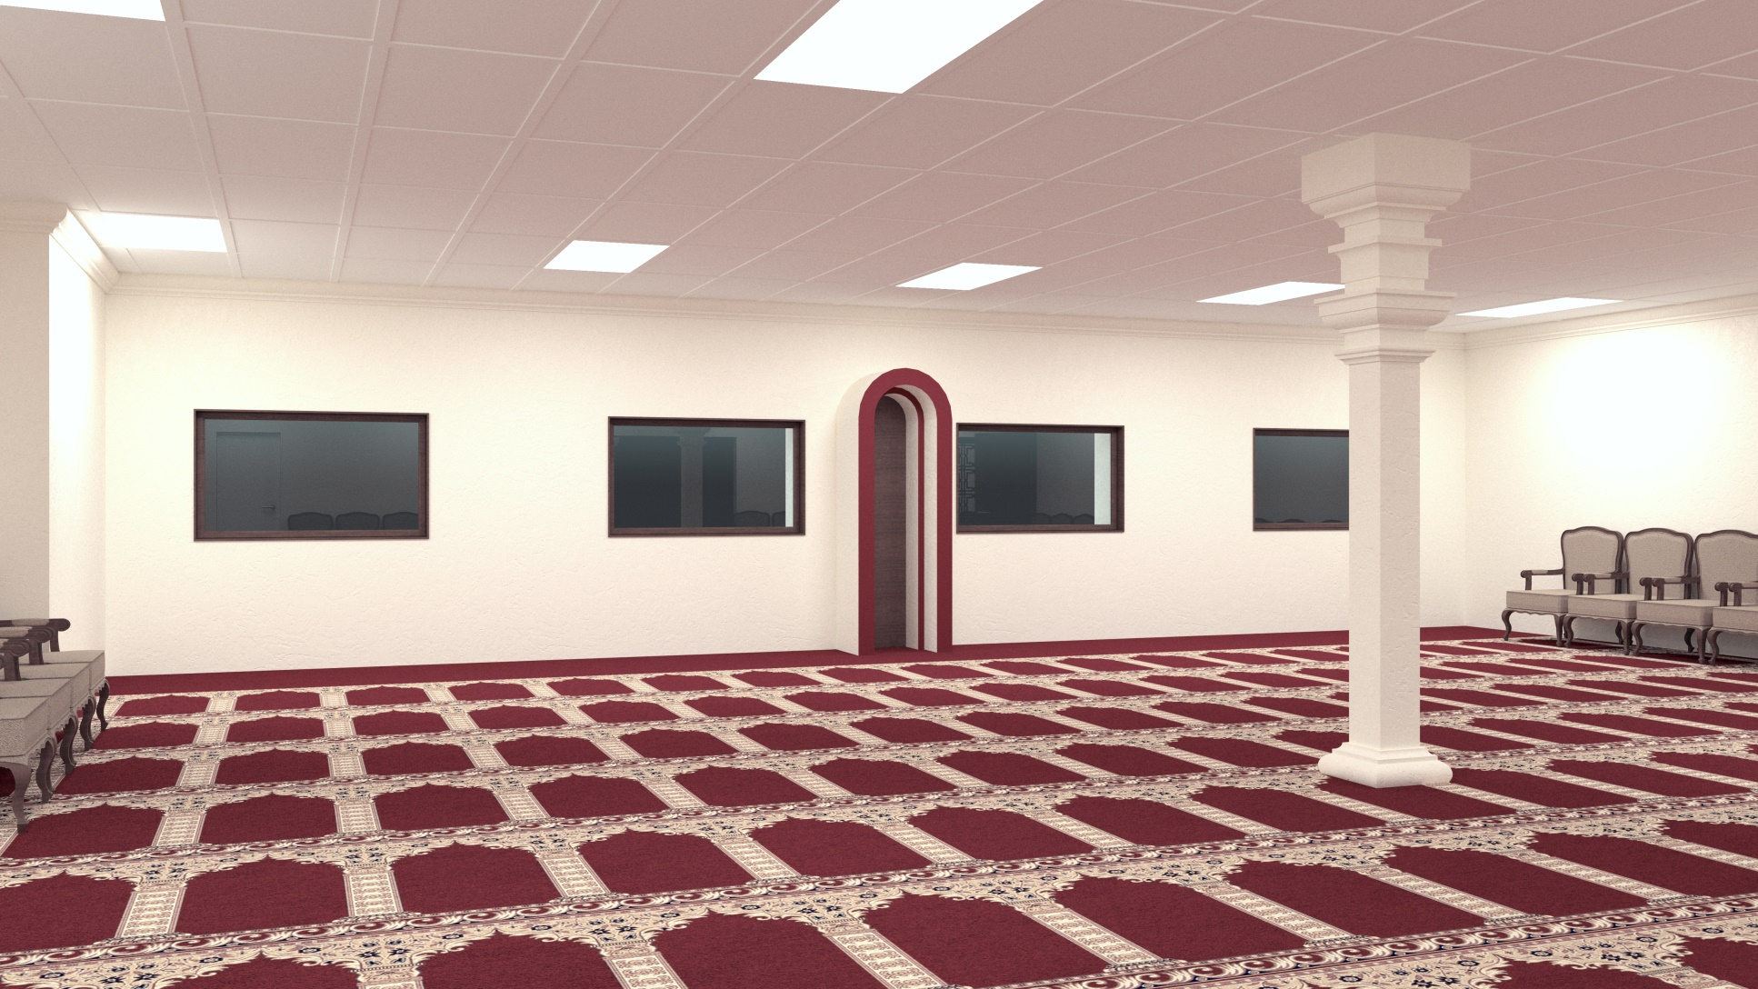
Noor Islamic & Cultural
Community Center
$ 500 per Praying Spot
Get/Sponsor One as a Gift for YOUR Parents
An Excellent Father’s Day Gift
A Gift that Lasts for EVER!

Slide 3
Praying Spot Gift
Noor Islamic & Cultural Community Center
4035 Treat Boulevard, Concord, CA 94518
Phone/Fax: (925)768-4885
Name: ___________________________________________
Address: _________________________________________
Phone: ___________________________________________
E-mail: ___________________________________________
Cash Check Credit Card
CC #: ____________________________ Exp. ____________
A Gift To: _________________________________________

